Slide 1
Dimensions of Development
ECONOMIC
POWER
SD
SOCIAL
ENVIORNMENTAL
SD: Field of Sustainable Development

Slide 2
Conflicts within Sustainable Development
Between:
the present and future generations
human well-being and the protection of nature
the poor and rich
a local and a global focus: ‘Here’ and ‘Elsewhere’

Slide 3
Conflicts: Nature-based conflicts (Ecological Conflicts)
EJAtlas.org
→ conceived by the Environmental Justice, Liabilities and Trade (EJOLT) project and funded by the European Commission as a global research project operated during 2011–2015. It maps ecological conflicts, resistances and environmental injustices, mostly in the developing world.
→ India recorded the greatest concentration of such conflicts, according to an article →published in Current Science (December 2015), showing the top 11 countries with respect to the number of cases reported to the EJAtlas database.

Slide 4
Cluster of environmental concerns –India

Slide 5
Understanding Environment-Society Interactions and their consequences
Chipko
Silent Valley
Water conflicts
Plachimada
Bhopal
Green Revolution
Dams and mutli-purpose projects
Forest Rights

Slide 6
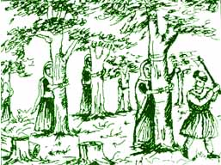
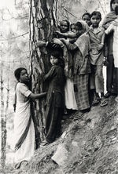
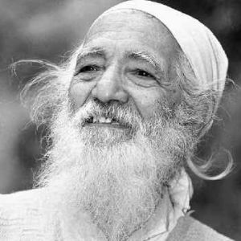
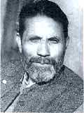
Chipko Movement

Slide 7
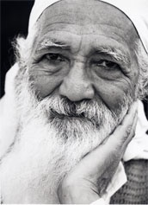
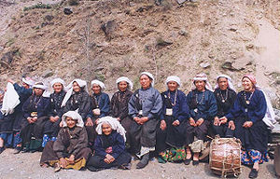
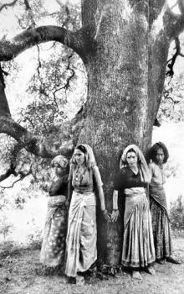
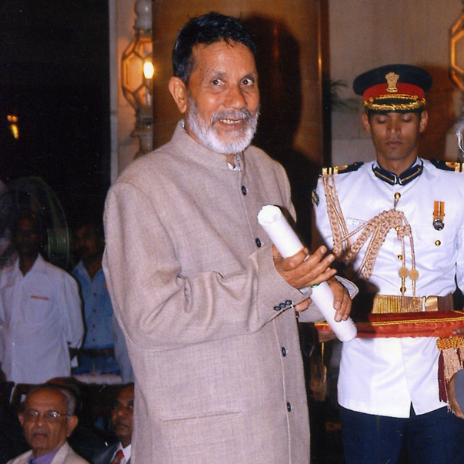
Chipko: Government, Paper Mills / Loggers, People
Sunderlal Bahuguna
Chandi Prasad Bhatt

Slide 8
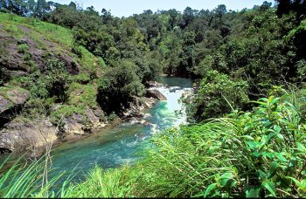
Silent Valley
1971-1985:- A remarkable people’s movement stopped a hydroelectric project across the Kunthipuzha River and saved a pristine evergreen forest in Kerala

Slide 9
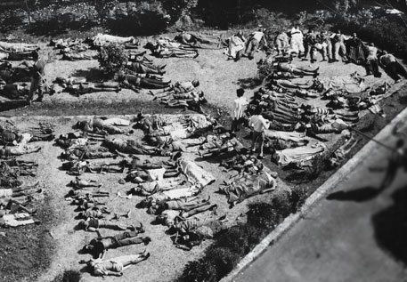
Bhopal Dissater
December 1984 at the Union Carbide India Limited (UCIL) pesticide plant in Bhopal, Madhya Pradesh. Over 500,000 people were exposed to methyl isocyanate (MIC) gas and other chemicals.
30 years of Bhopal gas tragedy: A continuing disaster
(Down to earth news & journal: http://www.downtoearth.org.in/coverage/30-years-of-bhopal-gas-tragedy-a-continuing-disaster-47634)

Slide 10
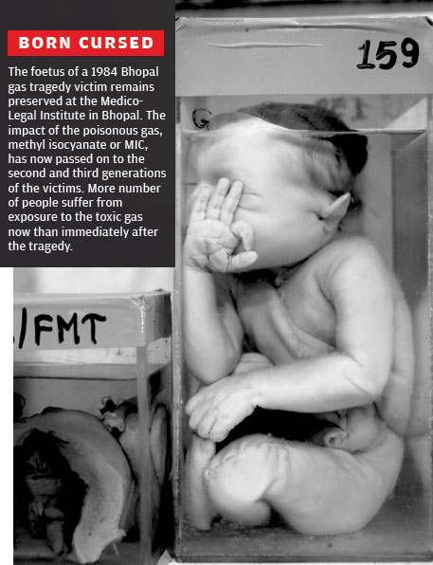

Slide 11
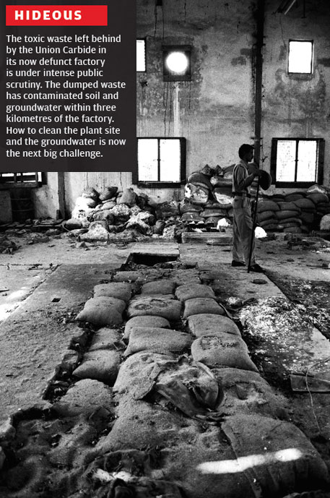

Slide 12
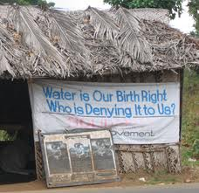
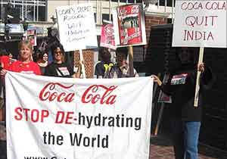
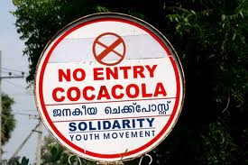
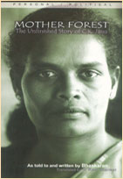
Plachimada struggle: Private ownership vs public access to water (Coca Cola)
To whom does ground water belong?
Adivasi Samkrashana Sangham (Adivasi Protection Front)
http://www.ritimo.org/The-Plachimada-Struggle-against-Coca-Cola-in-Southern-India

Slide 13
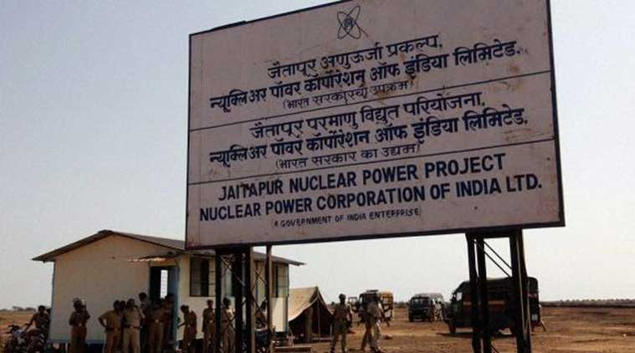
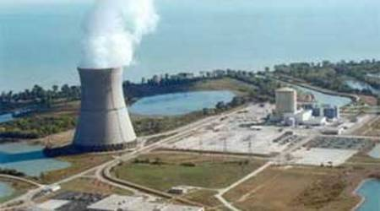
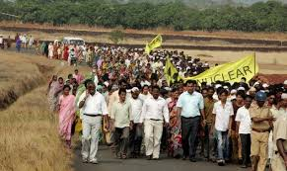
Jaitapur Nuclear power plant controversy-2010-2016
Resistance to Nuclear Expansion in India
Three reasons that make the project dubious & not worth pursuing
Troubled history of EPR
Expensive electricity
Seismic risk

Slide 14
Iron-Triangle:
Resource Omnivores
Eco-system People
Ecological refugees
By centralizing state power in the hands of technical and scientific experts, justified in the name of ‘national interest’, India’s rich traditions of decentralized governance, especially in the sphere of natural resource management, have been dismantled”—Gadgil and Guha, 1995. Book Ecology and Equity.

Slide 15
“No one, I repeat no one will be allowed to stand in the way of Orissa’s industrialisation and thepeople’s progress.”
→ Chief Minister Naveen Patnaik, commenting on the opposition to mining in Kashipur district, Orissa

Slide 16
You are all high-class people who live in Bombay, right? If there is a plan to make a huge dam in Bombay city, it’s obvious that the posh buildings where you reside would be submerged. Will you allow that to happen?”
→ Narmada Bachao Andolan activist Ramkrishna Bawa

Slide 17
The Omnivore-Ecosystem People Binary
Omnivores Eco-system People
Global, National, Local Reach Local Reach
Surplus Economy Subsistence Economy
Urban/Cosmopolitan Rural/Rooted
Sees itself as Modern/Scientific Is seen as traditional
Upper & Middle Classes Peasants/ Dalits/Adivasis
Separate from Resource Base Close relationship with resource

Slide 18
URBAN POPULATION
INDUSTRY
LARGE HOLDER OF IRRIGATED LANDS
BENEFICIARIES
STRONGLY LINKED TO INDUSTRIAL COUNRIES
DECISION MAKERS (Politicians)
ADMINISTRATORS (Bureaucratic)
Subsistence Sector Rural Landless Small Holders Rural Artisans Herders Fisherfolk Tribals Urban Slum Dwellers
At the cost of resource capital Quality Environment
Political Ecology of Development
(Gadgil and Guha, 1995)

Slide 19
Environmentalism of the Poor
Indian Ecological Struggles
Chipko
NBA
Silent Valley
Coke Plachimada
Chatisgarh Mukki Morcha
Conflict in Dantewada
Struggles over sea-TN, Andhra, Orissa

